Slide 1



MATRAS
Management of Training System
FULL STACK DEVELOPER
“Optimizing Training System for
Human Performance
by Digitalization system”
- MATRAS Team -
Alvany Maulana
Ahmad Abdurrahman
DM2260925|BF23-PW
DM2260925|MTN

Slide 2

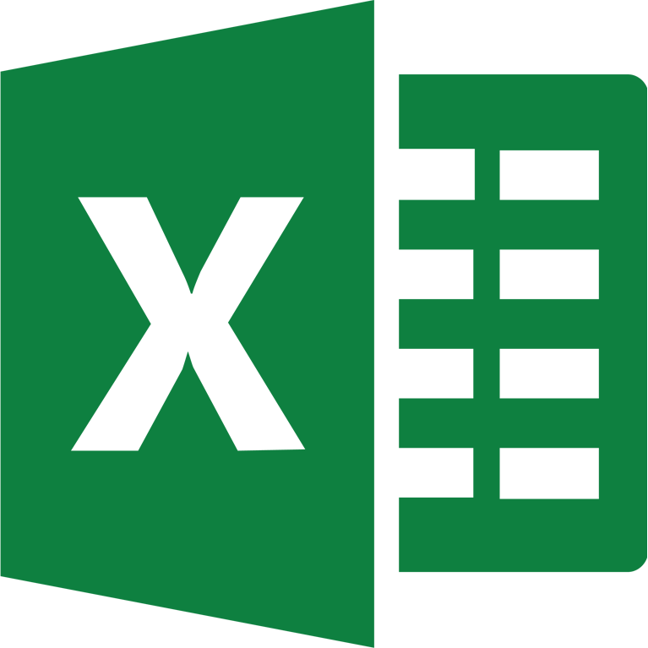












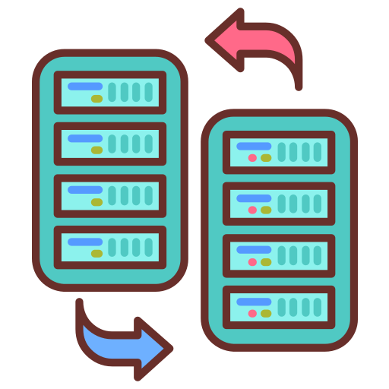







A Smart Transformation in
Management Training System
when one process =
5 minutes
HRD
Excel
Ms. Form
DOJO PARTICIPANT
Get data from Ms. Form ➔ Copy to Excel ➔ Edit
WOT
Transfer participant data by WA Group
10 process worked by input manually
CURRENT CONDITION
There are
DOJO
TRAINING
Efficient and Effective Management Training
There are participants who double the training.
so it wastes time
- Way Of Thinking
Total Process before improve Need times for
15,5 Minutes
GOALS
The data input process is still manual so it is not effective
Minimum man hour with effective work and accuracy data.
There is a repeat of sending participant data through to
HR ➔ Muda process
1. Dojo ➔ Result score to HRD
There is no MEIRUKA About Summary data
2. HRD ➔ Data MCU to Dojo
3. Dojo ➔ Distribution Data to HRD
PURPOSE
1
3
4
TARGET
TIMELINE
Create Participant Imports that can detect duplicate participants.
Optimize the training process for more effective time utilization.
We will connect HR and Dojo’s data flow for smoother operations
1
0 duplicate participants who join the training
10-14 july 2023
31-2 august 2023
2
2
Efficiency process of Inputting Data
Prepare
Development
Trial
Presentation
We will set up automatic ways to put in information for accuracy and speed
3
Efficiency work time up to 5 minutes
4
Eliminate Muda process Between HR and Dojo
16-27 july 2023
4 august 2023
Enhance overall productivity By reducing man hours to higher-value activities.

Slide 3










DETAIL SYSTEM
Pair Programming
Old Flow
DOJO
HRD
Vs. Code
Database
Web Server
Collect personal data by Microsoft form and edit in excel manually
Conduct MCU tests on participant who pass. And give the results to Dojo by Microsoft teams
Evaluation
Visualization
02
04
DISTRIBUTION
01
03
TRAINING
EVALUATION
HRD
DOJO
DOJO
Notifies to Dojo new participant who will be training by WhatsApp
Manage All Score (Copy, Paste, Edit) in Excel And give to HRD by Email.
Combine Result MCU Tests and summary score then input to bank participant file manually (Copy, Paste, and Sort by rank)
FEATURES
New Flow
DOJO
"Accurately assessing
scores from
Microsoft Forms."
Collect personal data by Microsoft form and import to web
HRD
02
04
Conduct MCU tests on participant who pass. And Edit by web if participant failed.
01
03
TRAINING
EVALUATION
DISTRIBUTION
HRD
DOJO
DOJO
Notifies to Dojo new participant who will be training by WhatsApp
Import All Score from Excel to Web, And HRD can monitoring the result directly.
All Participants who pass directly enter the participant’s bank.
"Efficiently managing participant data transfers to participant banks."
Identifying User Needs that Align With Our Capabilities Can be a Challenging Task.

